Slide 1


Slide 2
Period of Soviet Assistance
1953-1960

Slide 3


Slide 4
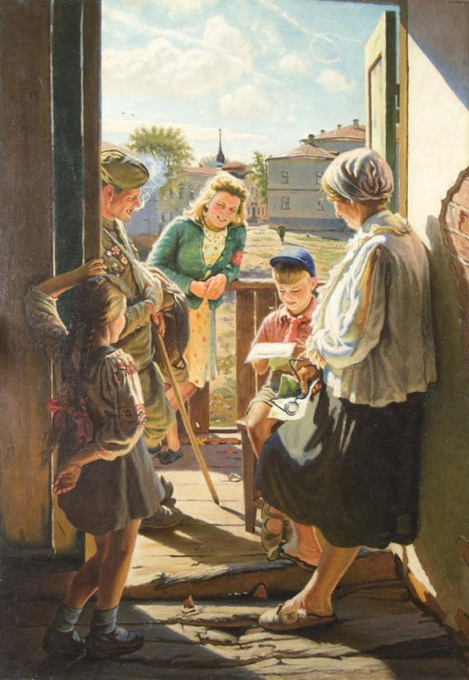

Slide 5
Konstantin Maksimov
in PRC
1955-1957

Slide 6
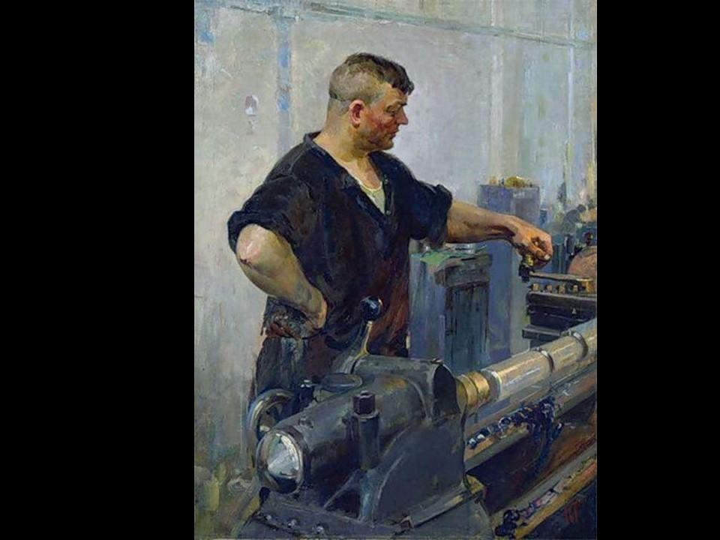

Slide 7
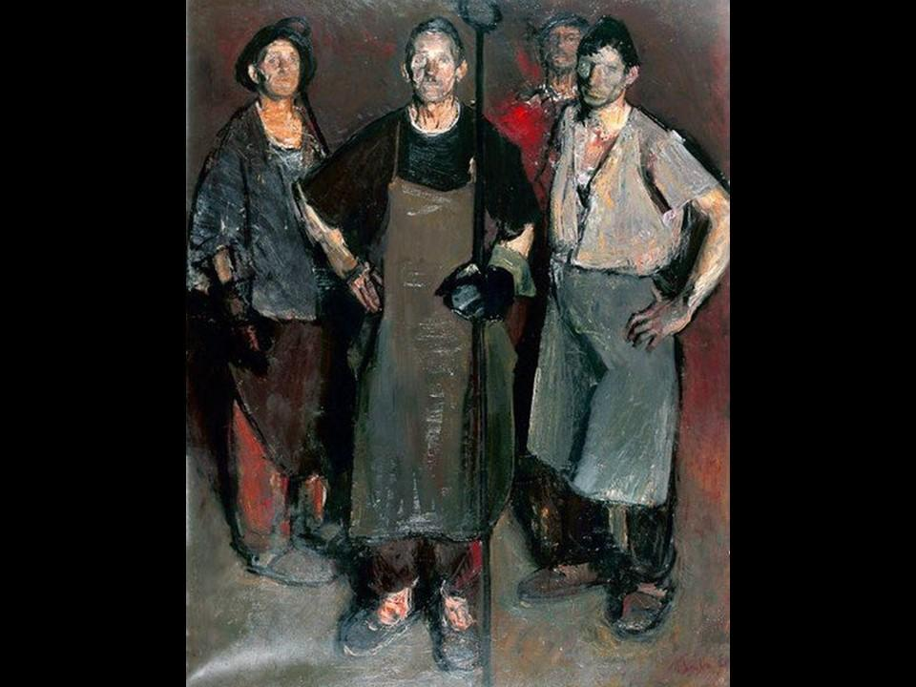

Slide 8
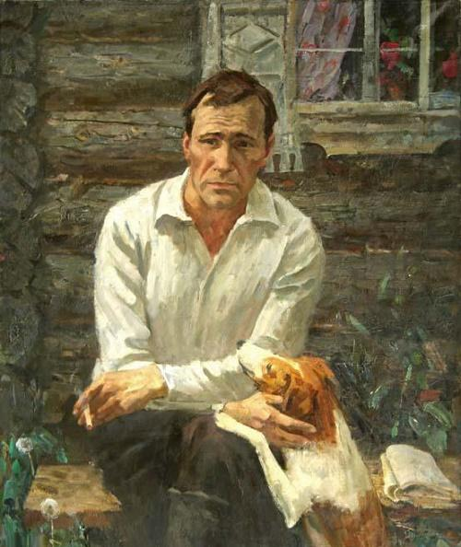

Slide 9
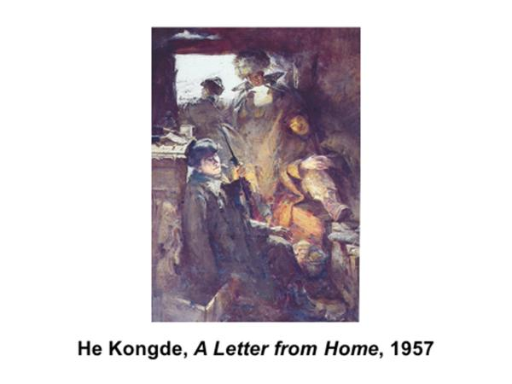

Slide 10
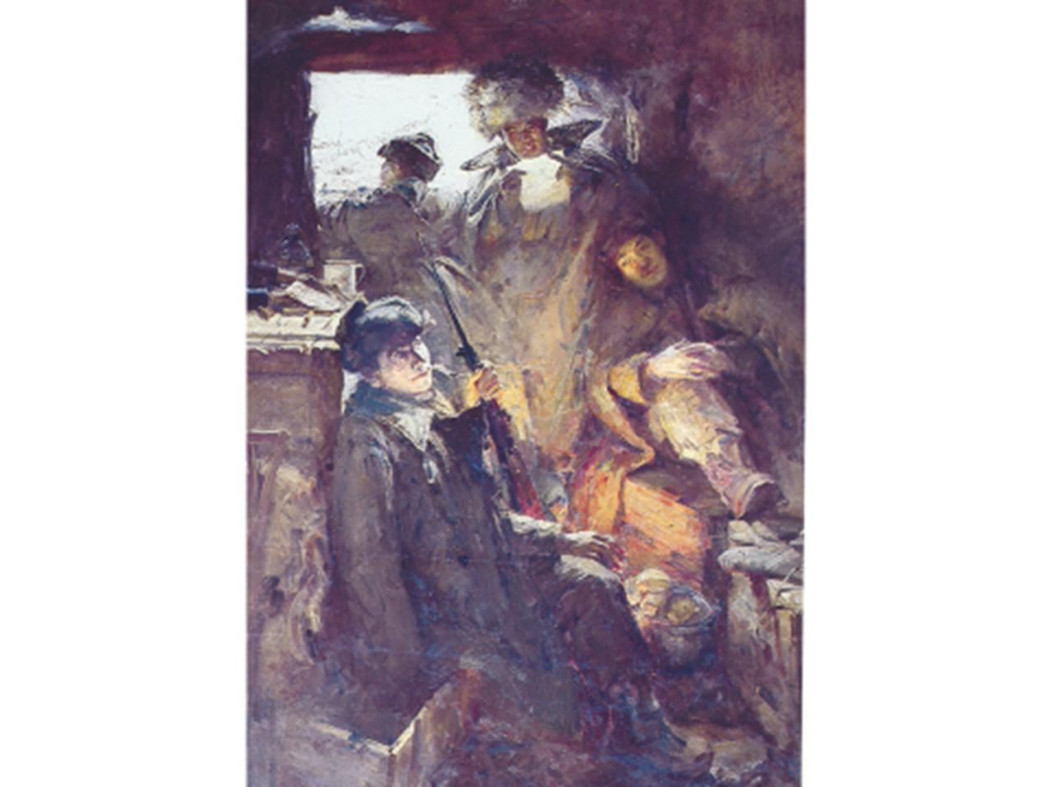

Slide 11
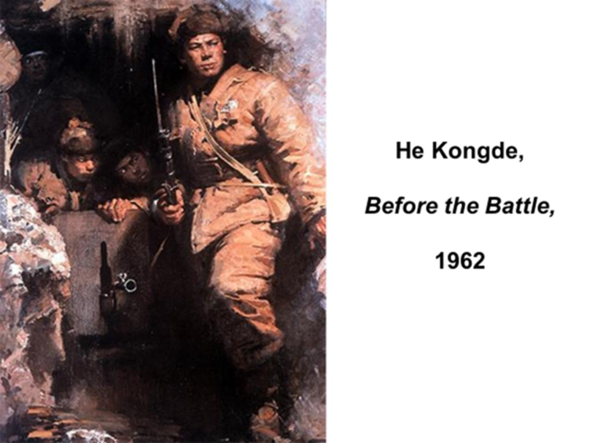

Slide 12
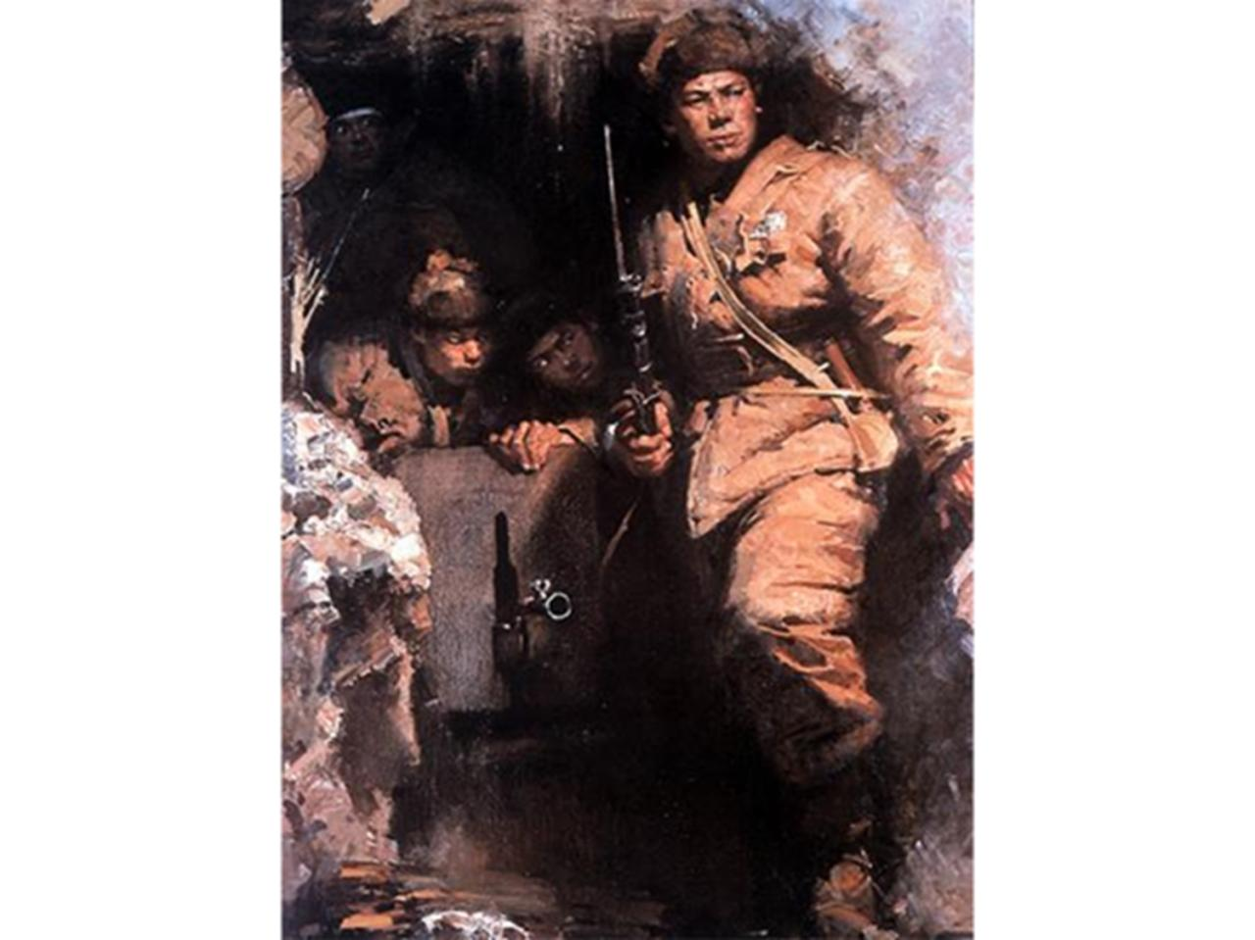

Slide 13
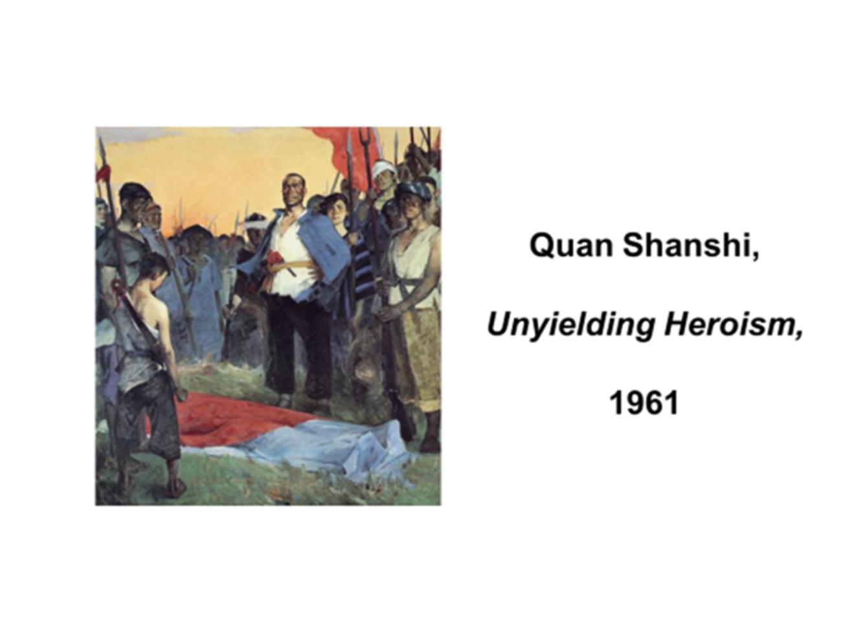

Slide 14
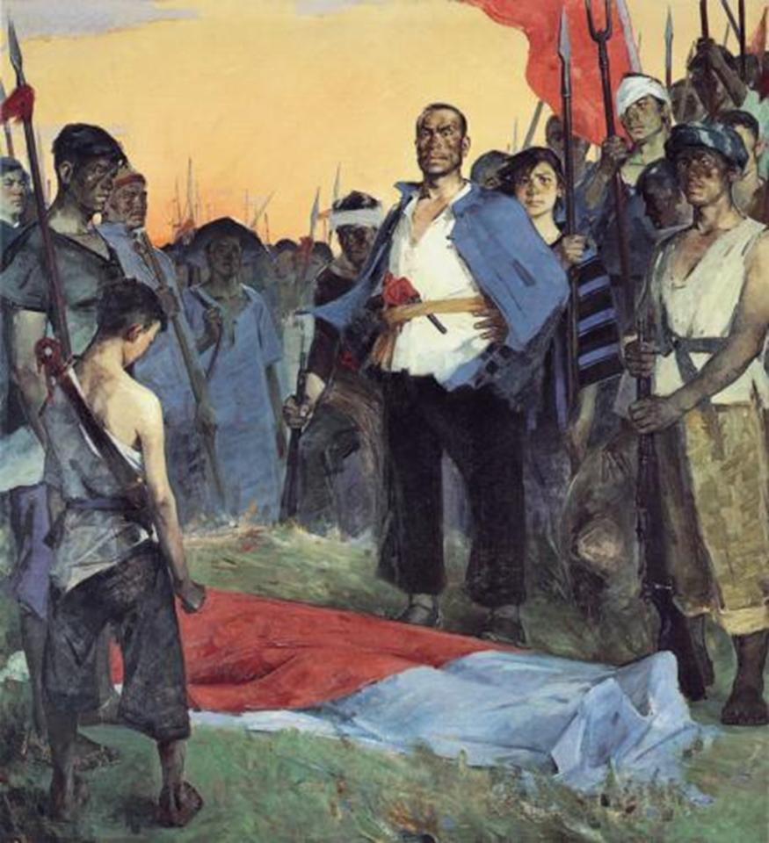

Slide 15
Re-emergence of guohua
1953 - 1965

Slide 16
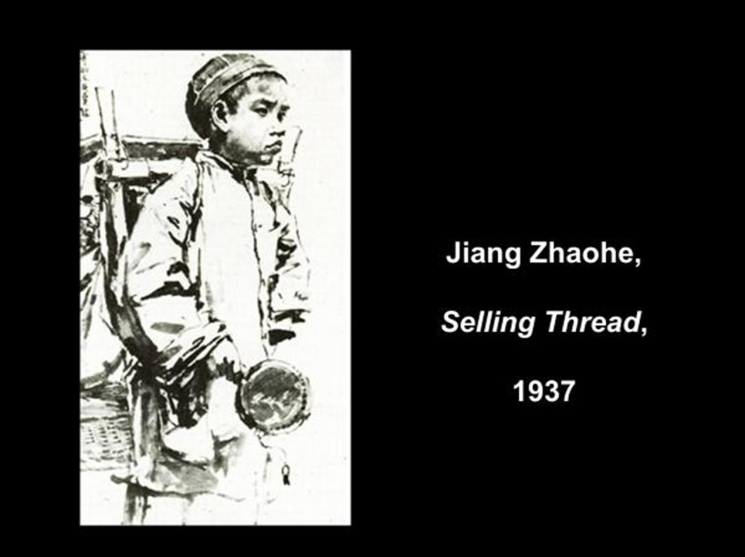

Slide 17
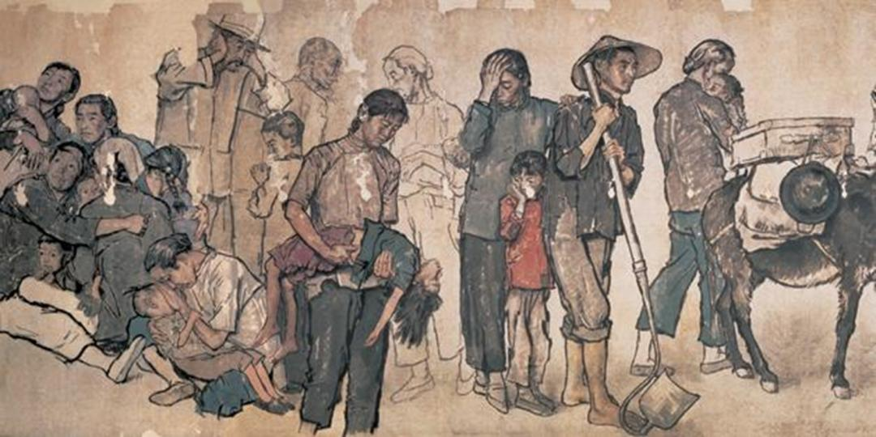
Jiang Zhaohe, Refugees (detail),
26 meters, 1943

Slide 18


Slide 19


Slide 20
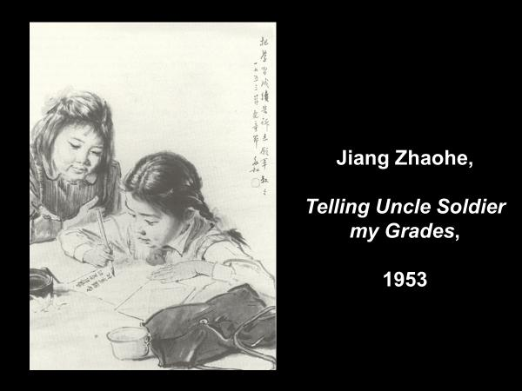

Slide 21
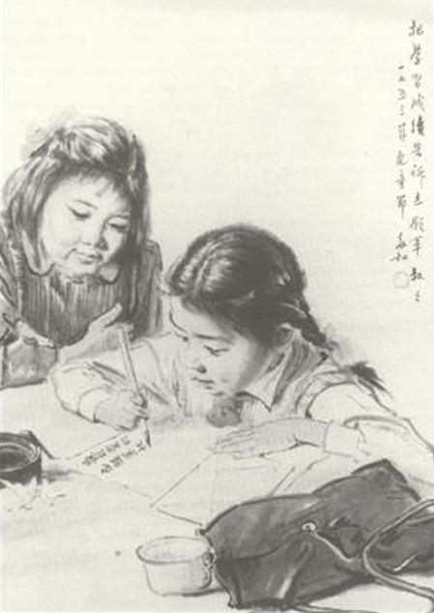

Slide 22
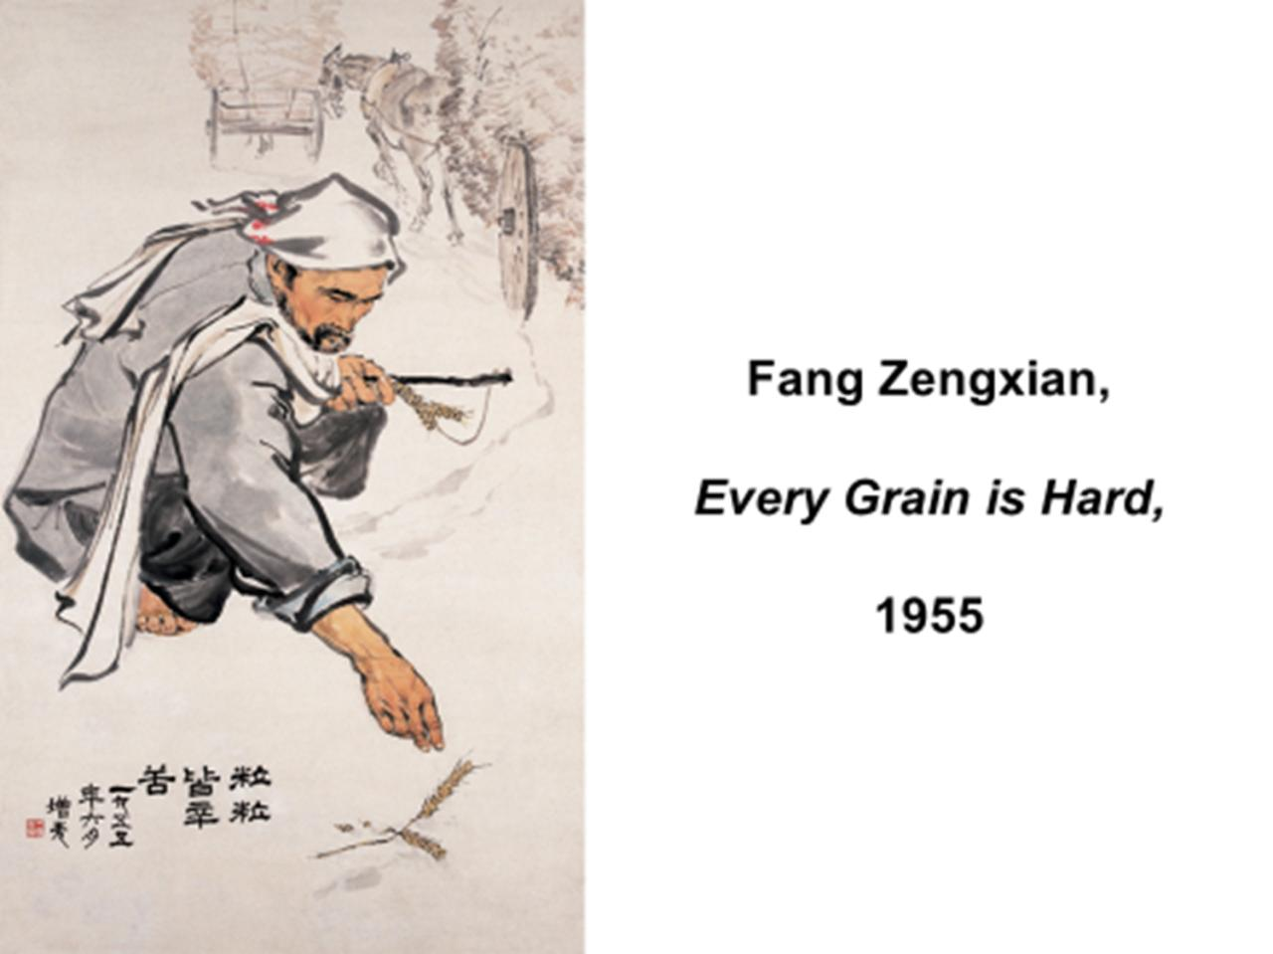

Slide 23
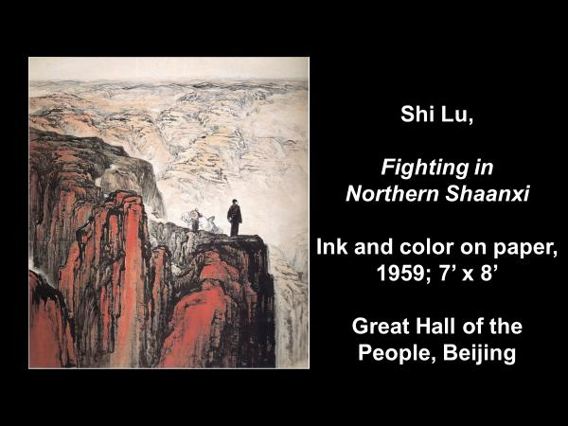

Slide 24
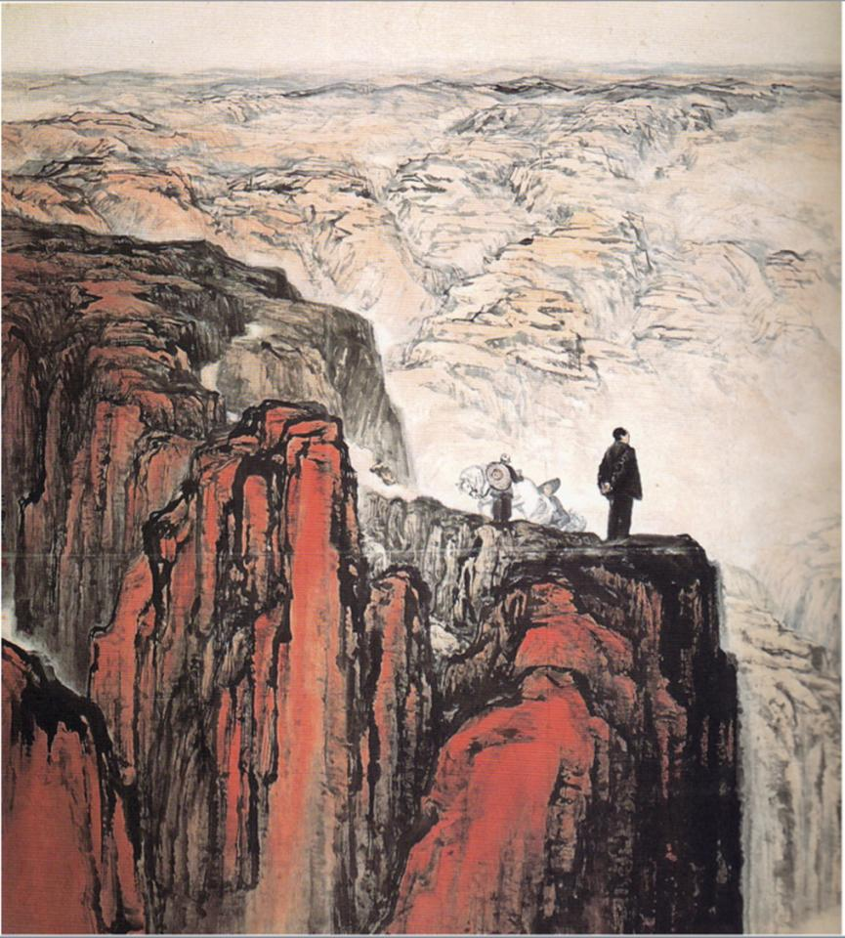

Slide 25


Slide 26
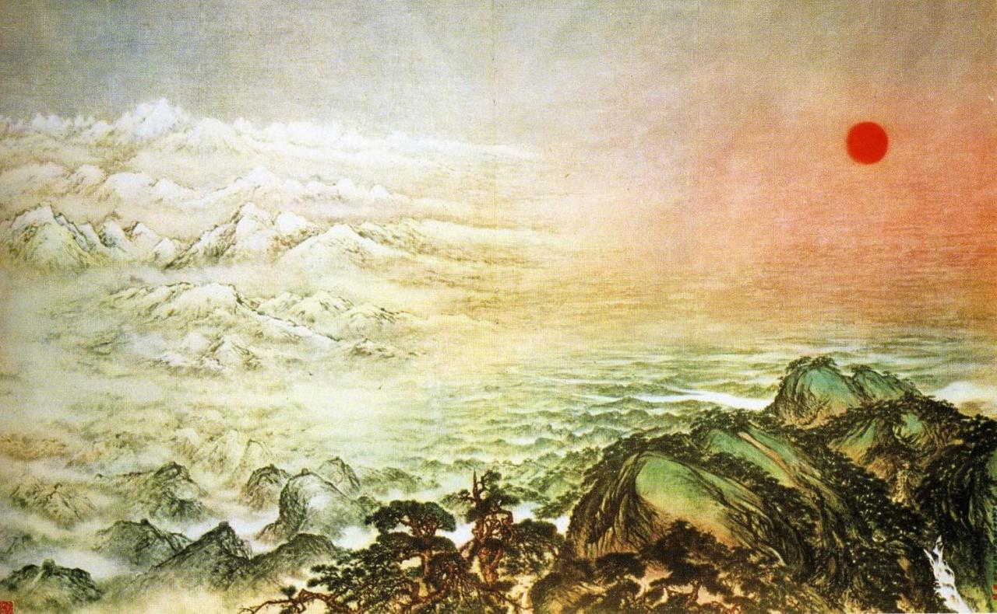

Slide 28
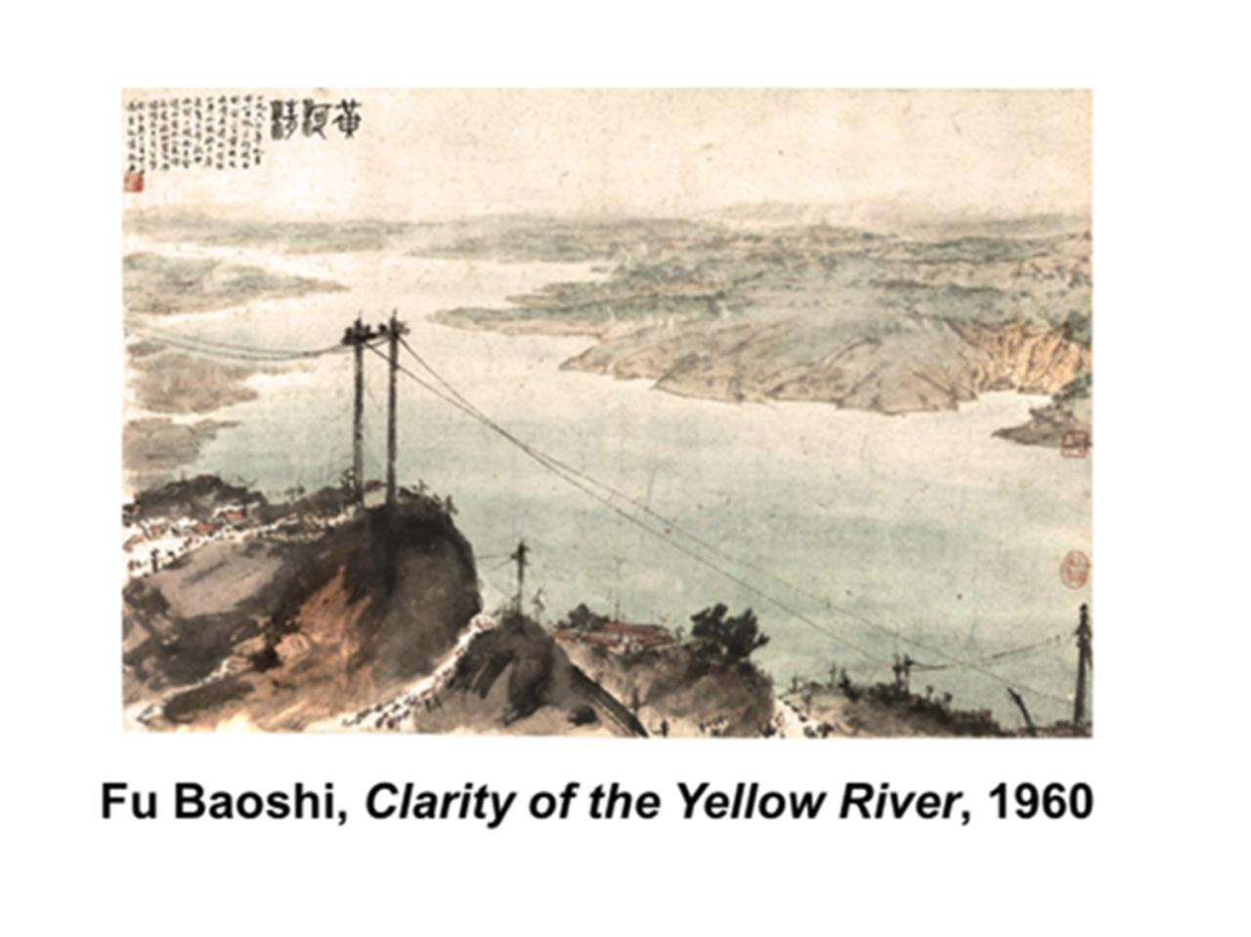

Slide 29
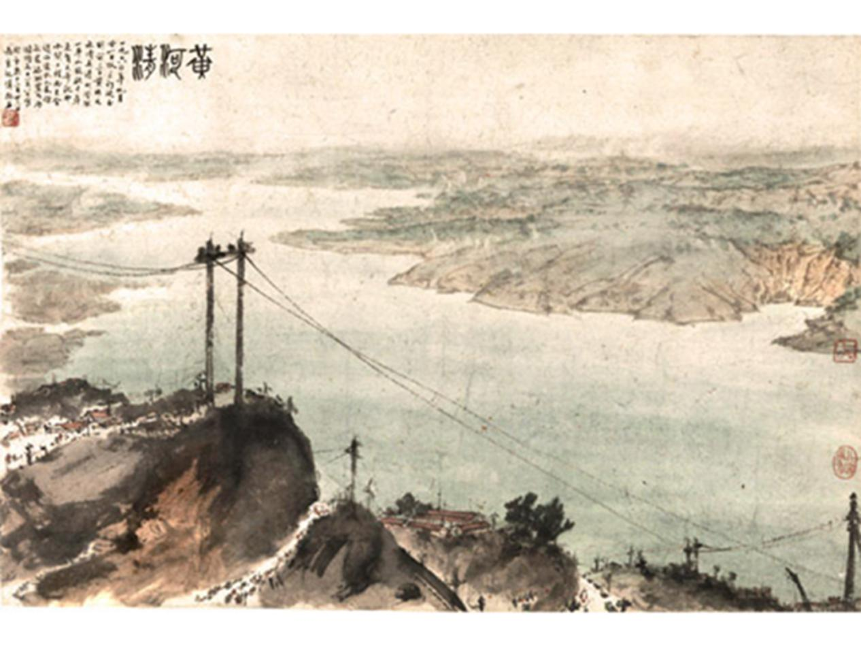

Slide 30
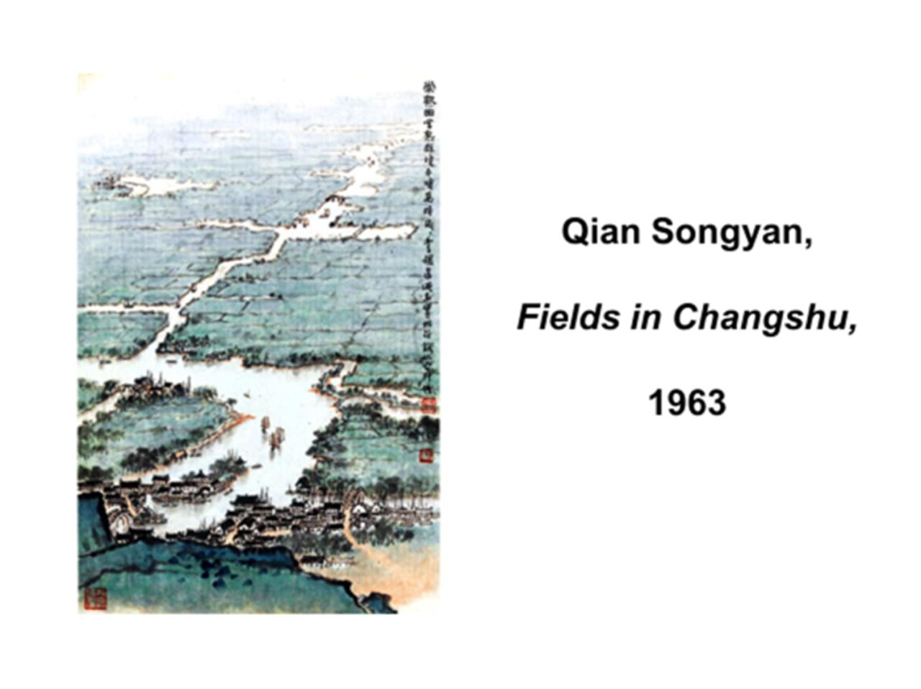

Slide 31
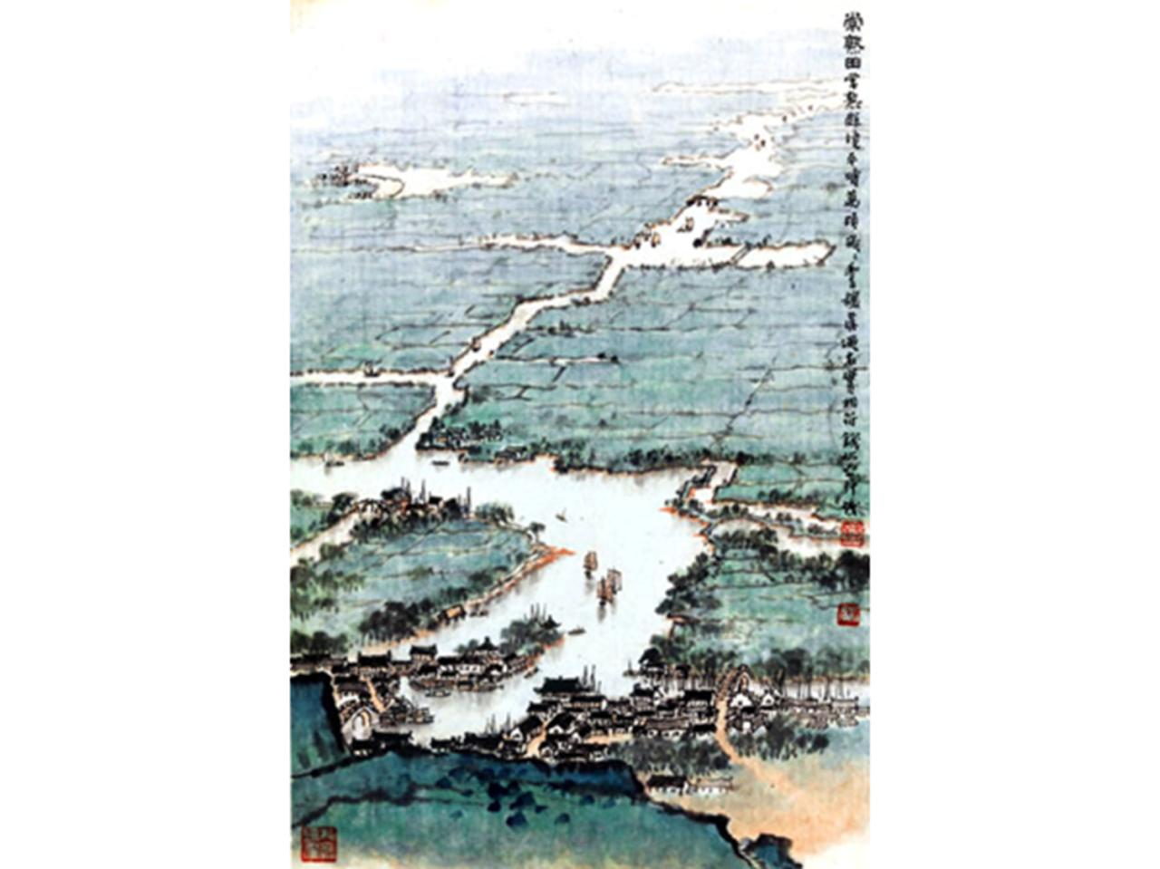

Slide 32
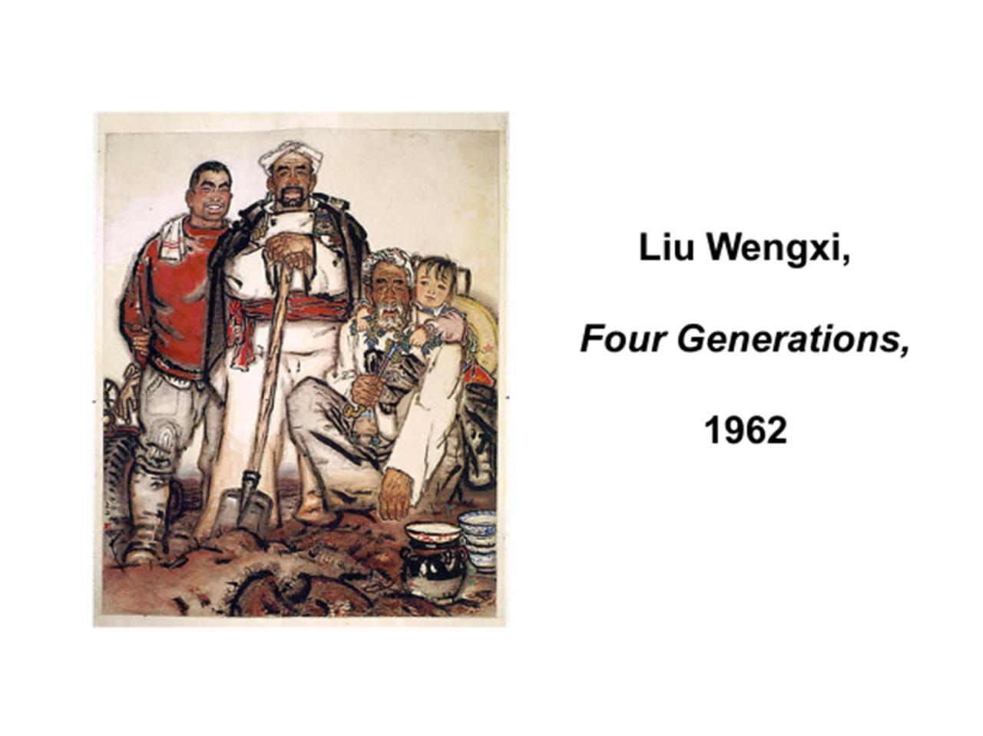

Slide 33
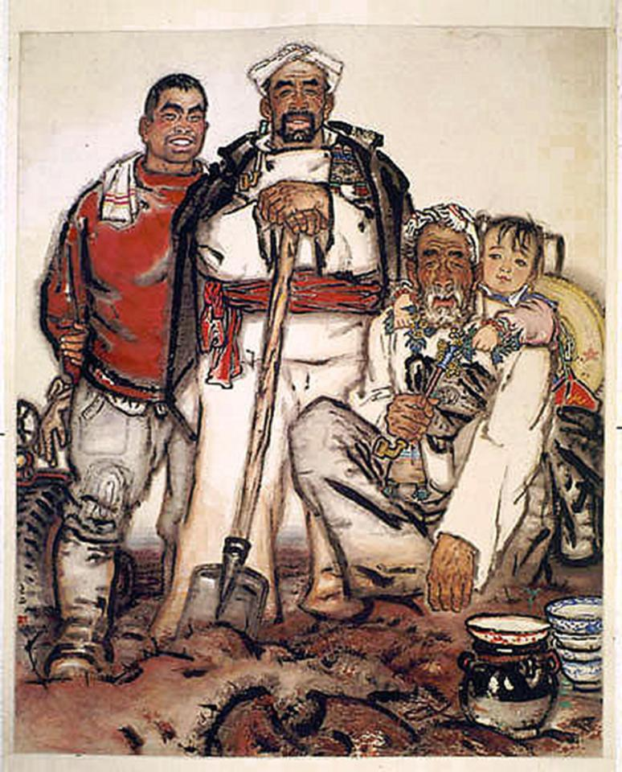

Slide 34
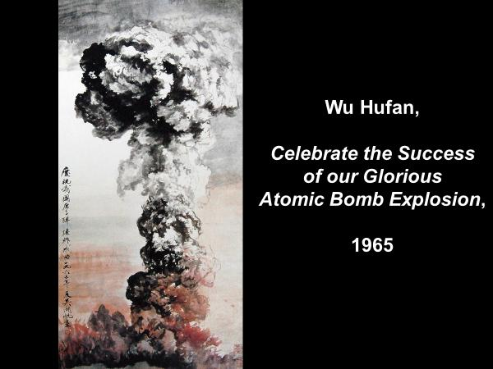

Slide 35
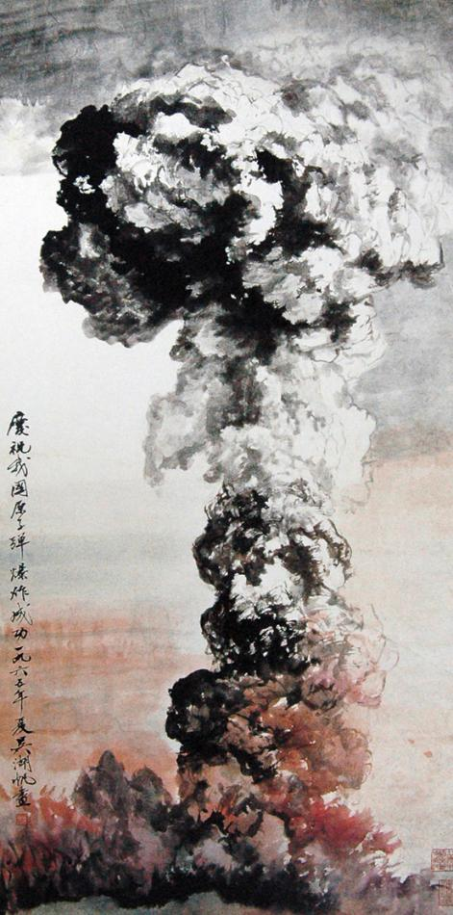

Slide 36
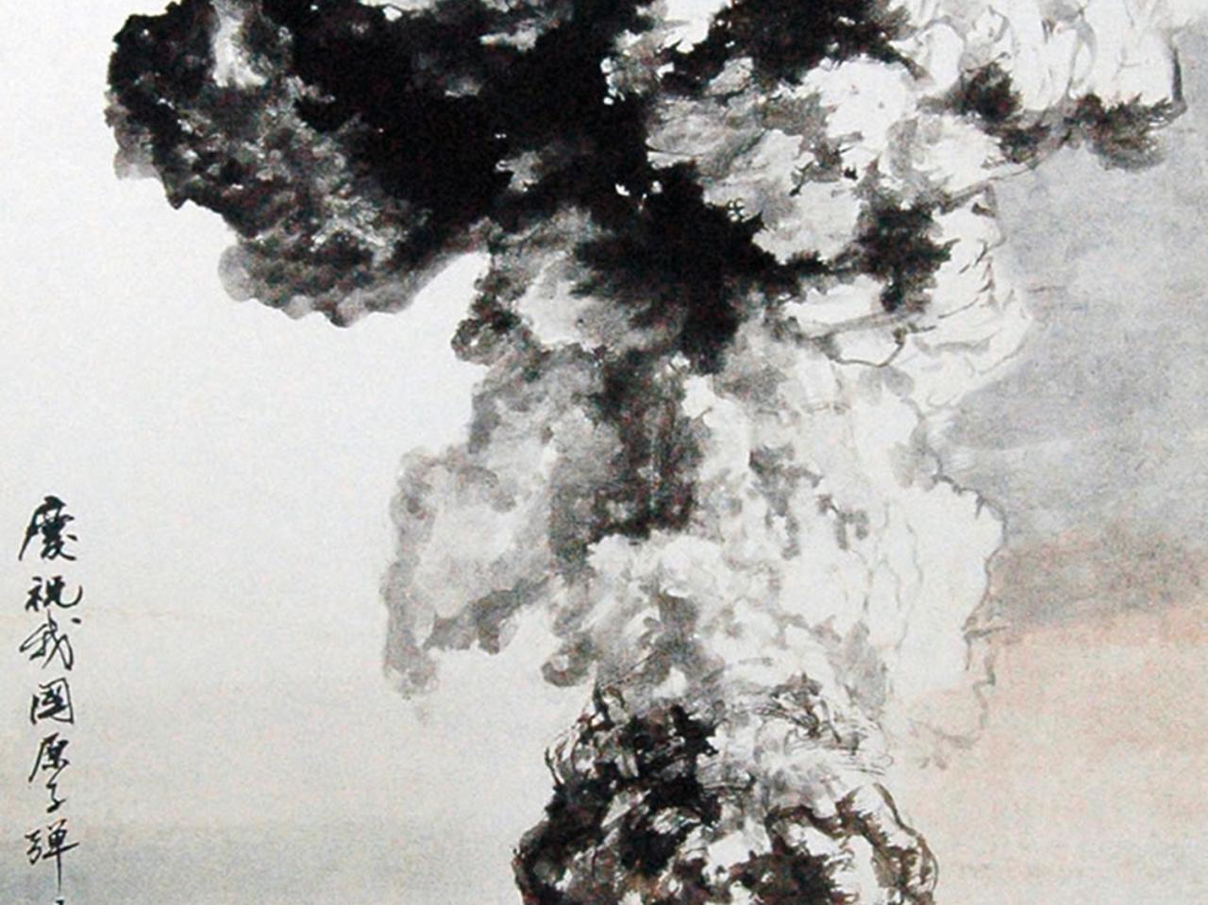

Slide 37
New tendencies 1959 - 1966
(Precursors to
the Cultural Revolution)

Slide 38
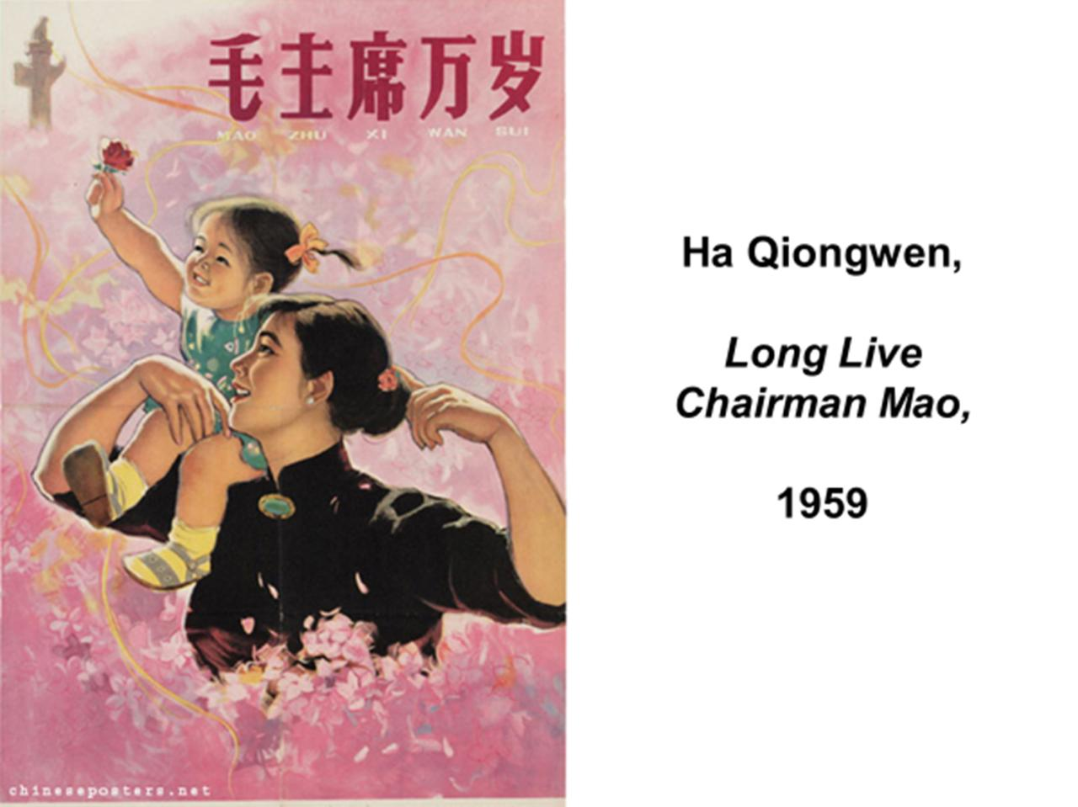

Slide 39
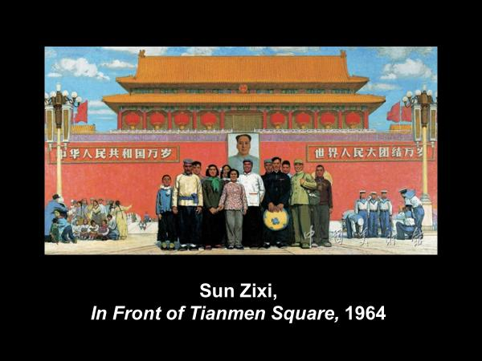

Slide 40
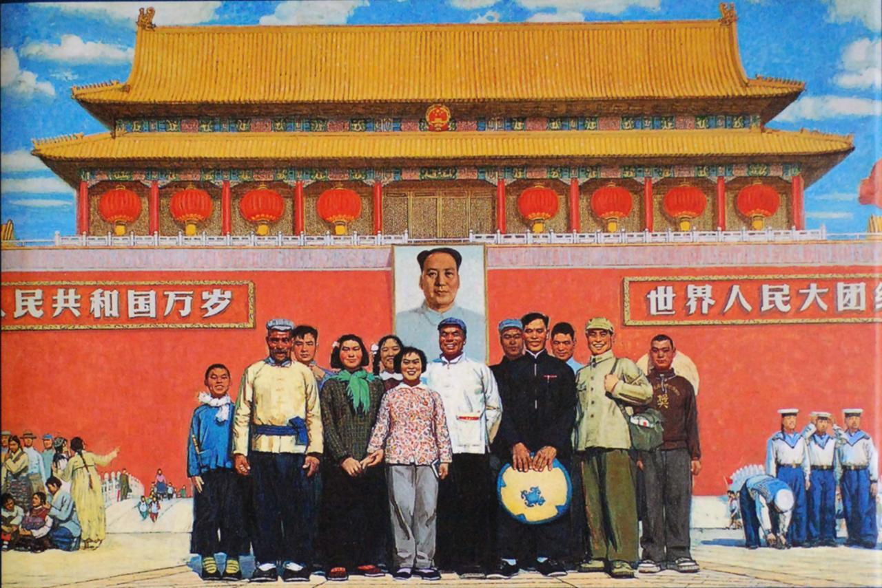

Slide 41
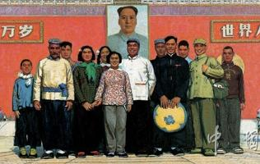

Slide 42
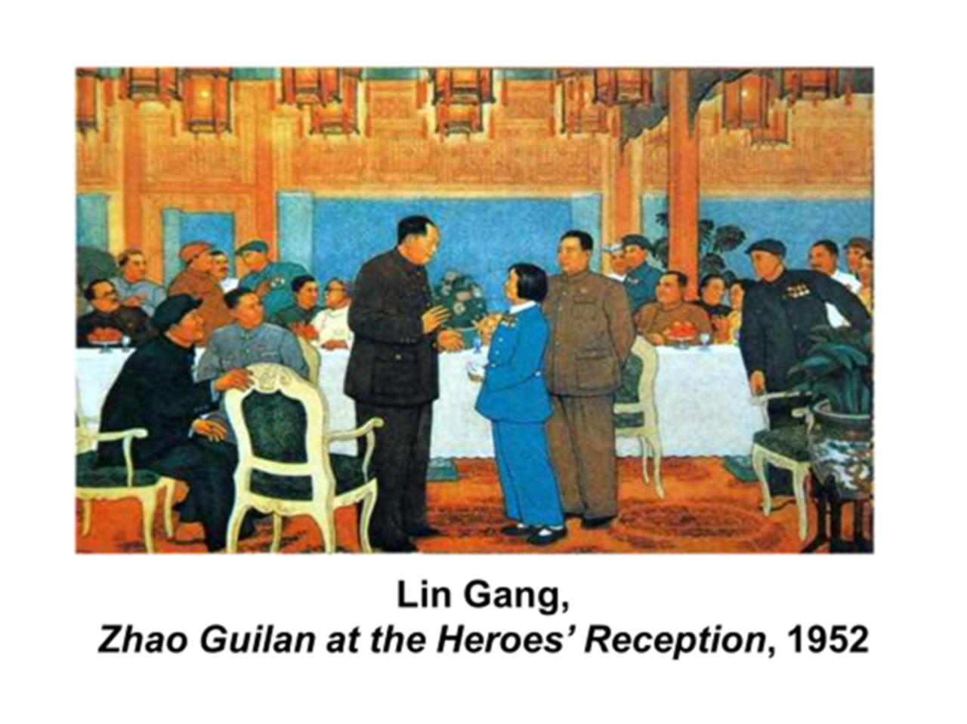

Slide 43
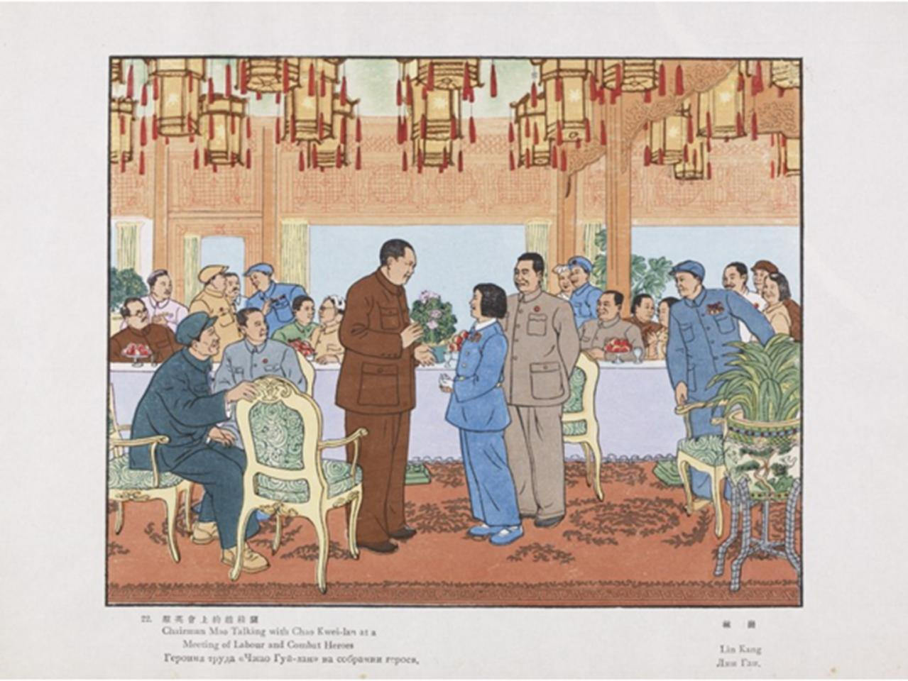

Slide 44
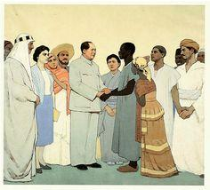
Wu Biduan and jin Shangyi,
Chairman Mao Standing with People of Asia, Africa, and Latin America,
1961

Slide 46
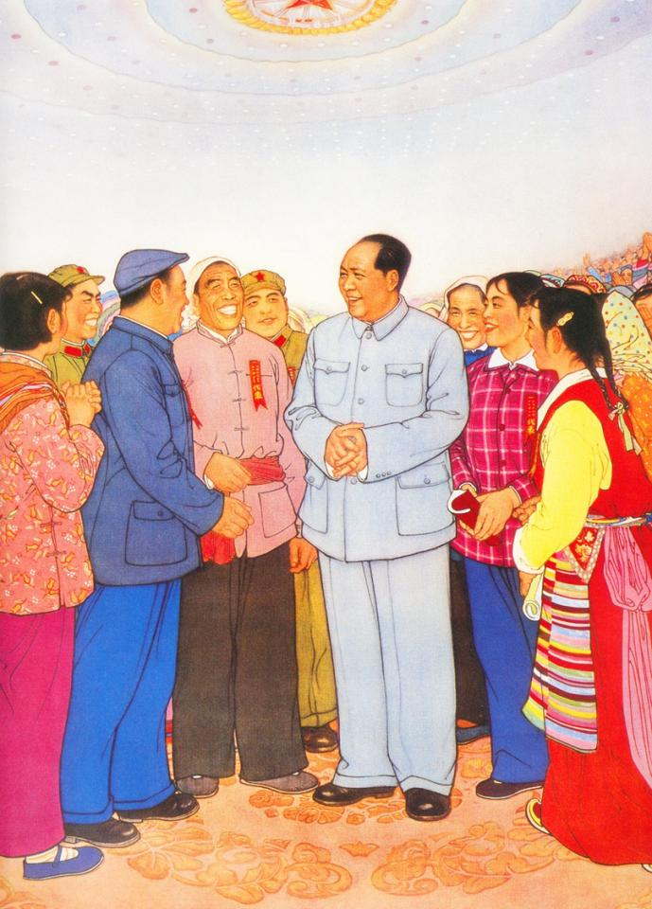

Slide 47
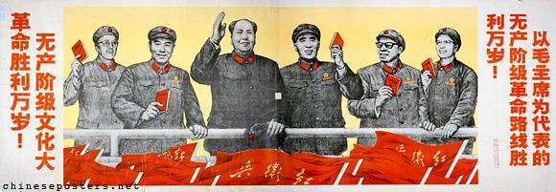
The Great Proletarian
Cultural Revolution
1966 - 1976

Slide 48
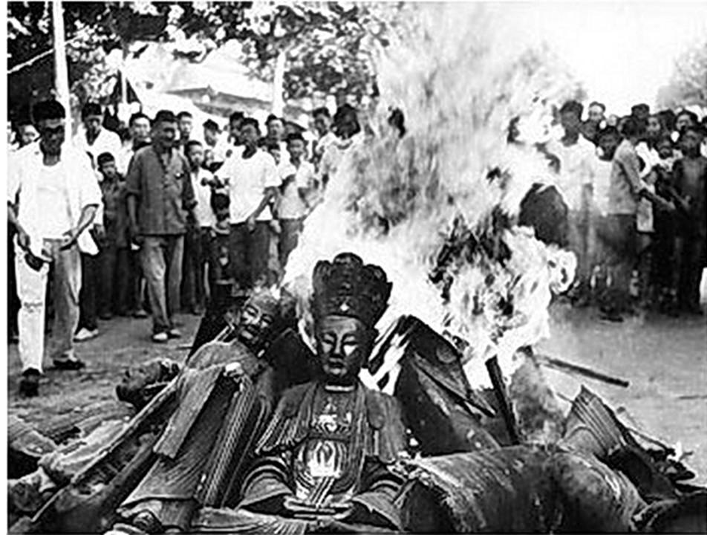

Slide 49
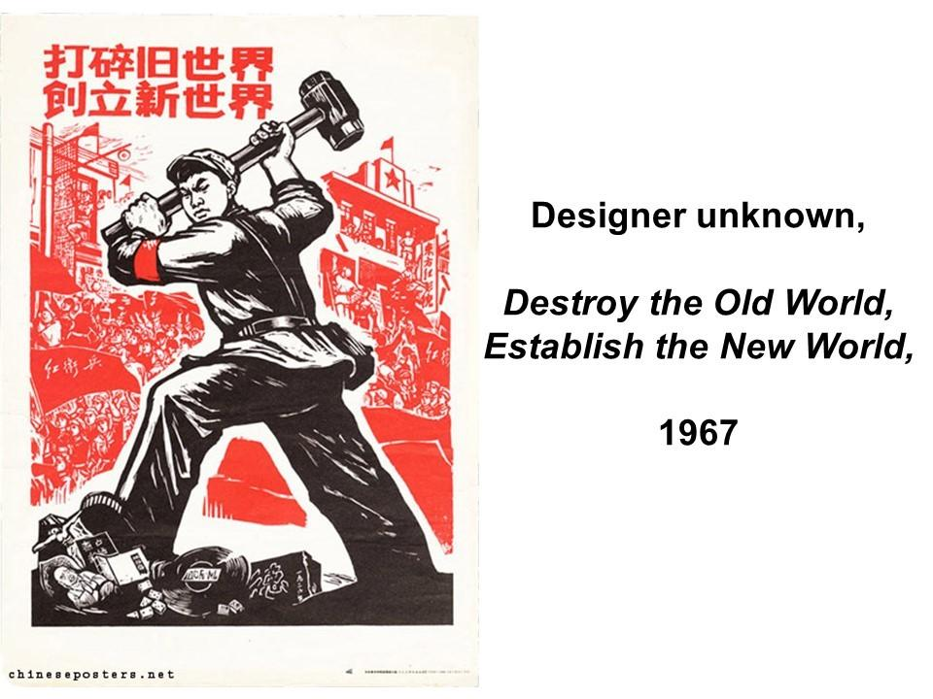

Slide 50
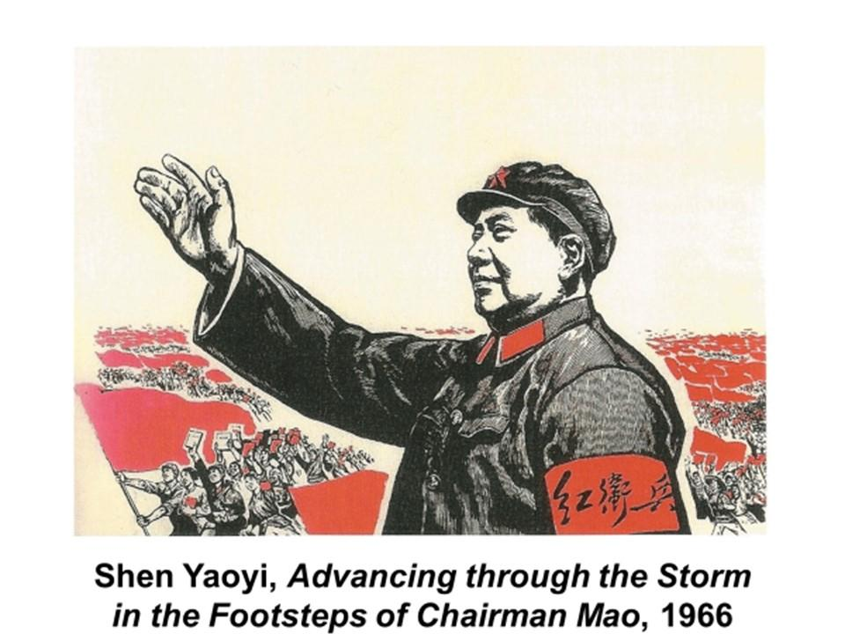

Slide 51
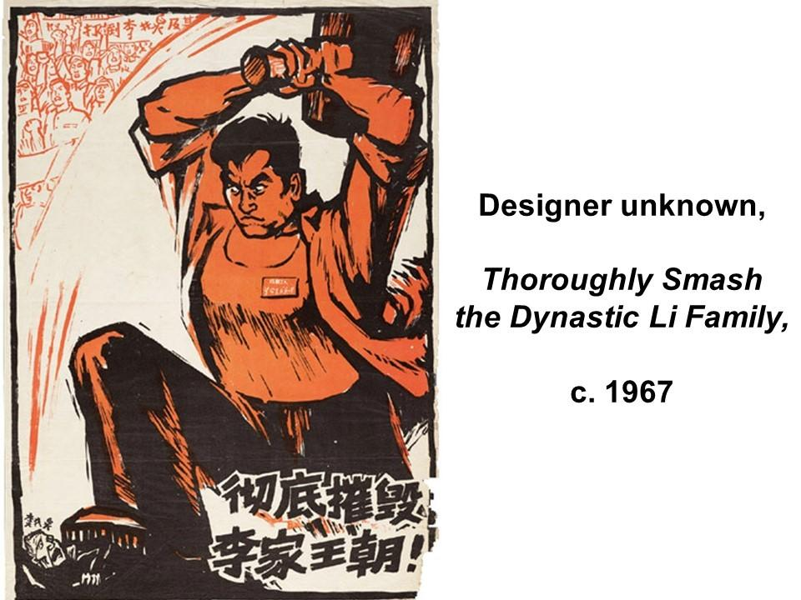

Slide 52
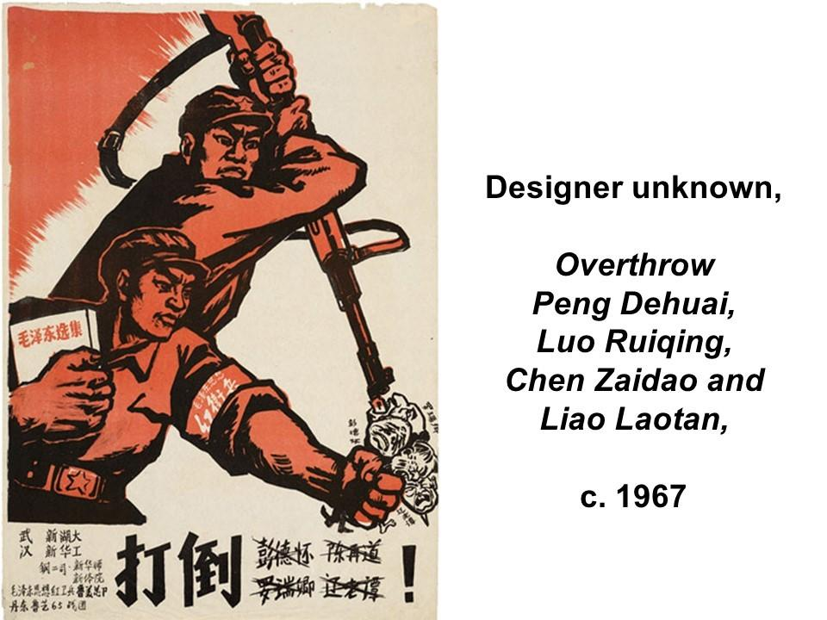

Slide 53
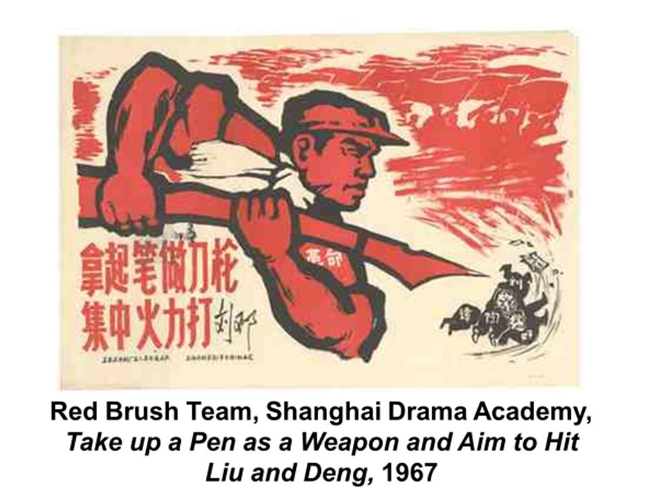

Slide 54
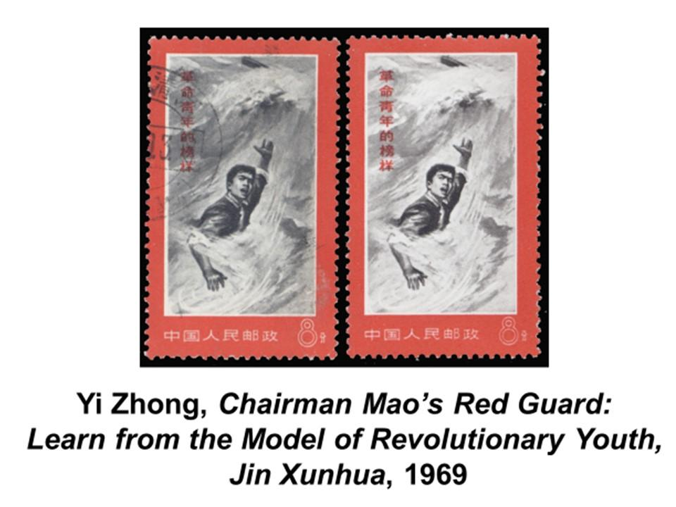

Slide 55
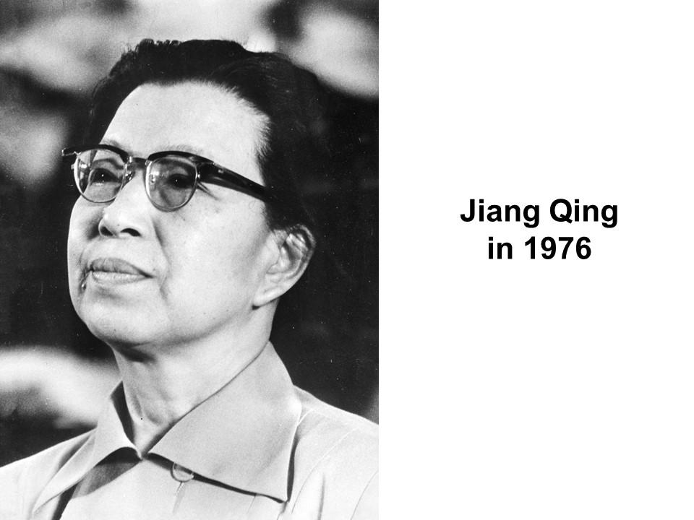

Slide 56
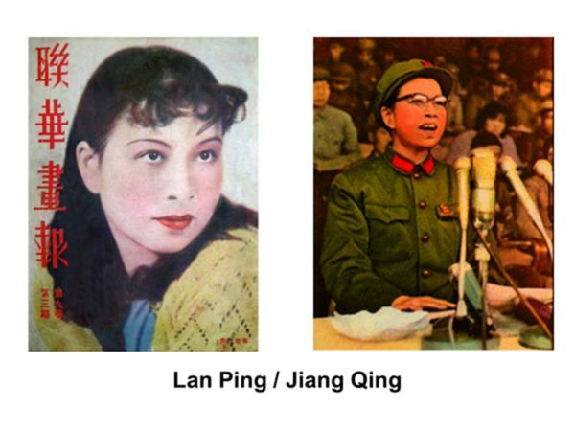

Slide 57
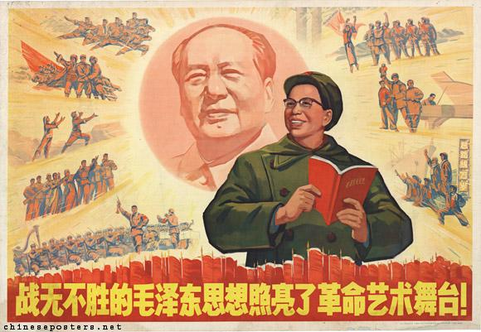

Slide 58
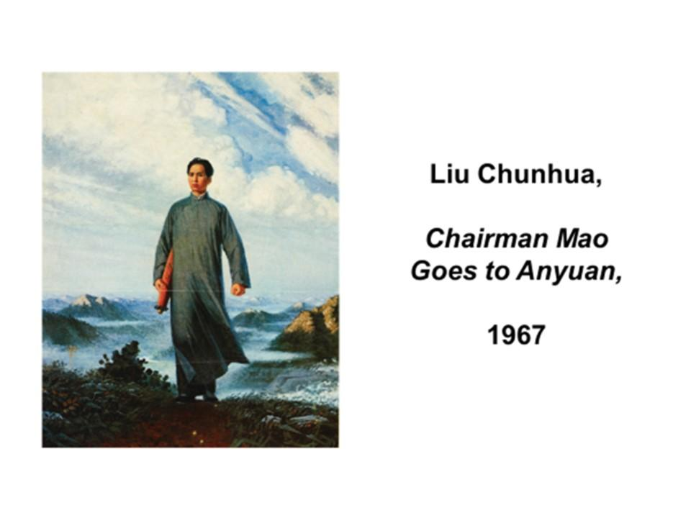

Slide 59
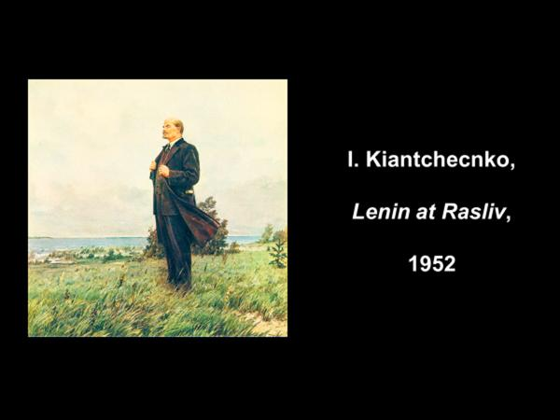
)

Slide 60
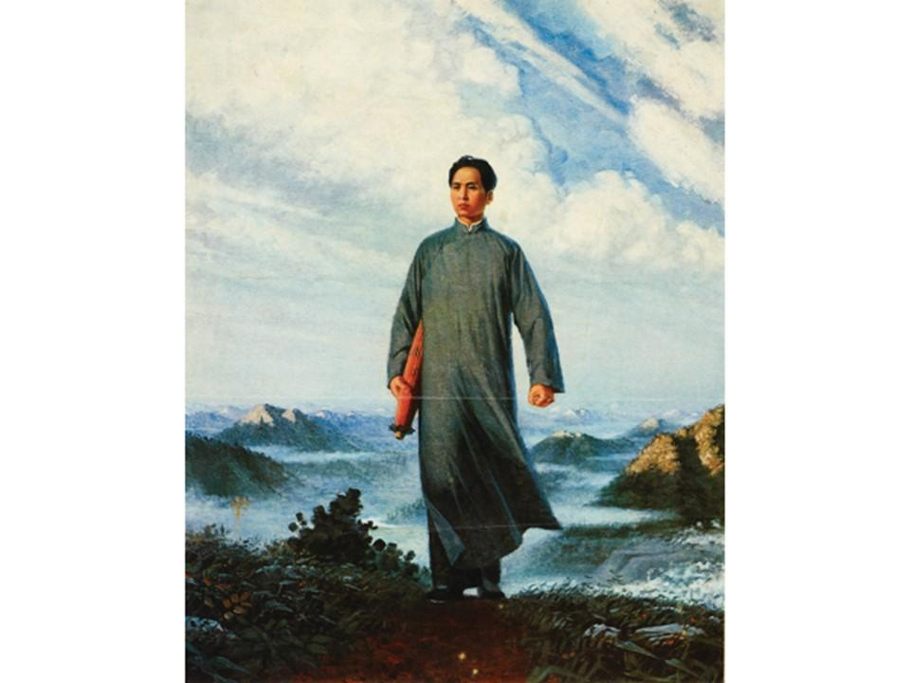

Slide 61
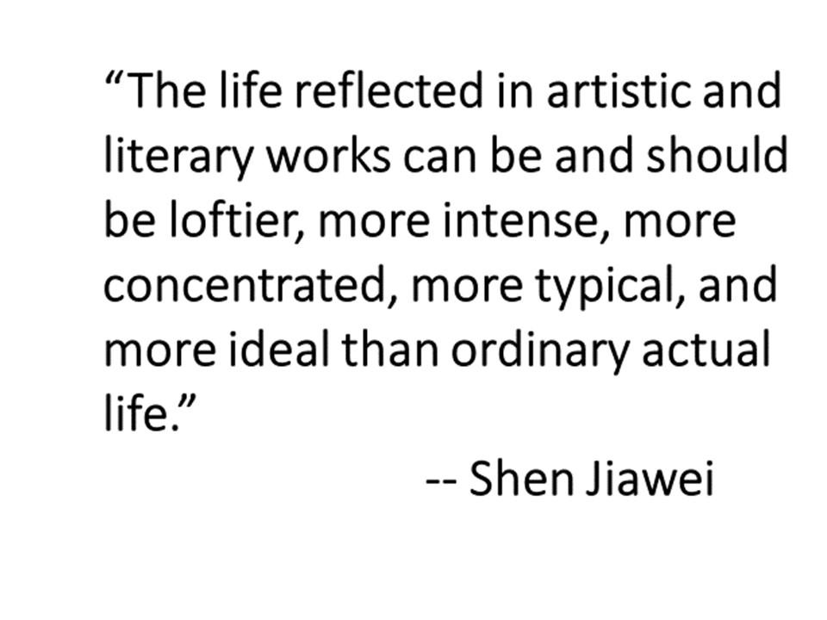

Slide 62

Zhou Shuqiao, Willow in the Spring Wind,
1974

Slide 64


Slide 65


Slide 66


Slide 67


Slide 68


Slide 69


Slide 70


Slide 71


Slide 72


Slide 73


Slide 74


Slide 75


Slide 76


Slide 77


Slide 78


Slide 79


Slide 80


Slide 81


Slide 82


Slide 83


Slide 84


Slide 85

Chen Yanning,
New Doctor in
the Fishing Village,
1974

Slide 87


Slide 88


Slide 89


Slide 90


Slide 91


Slide 92
Wu Qionghua, a house maid, is abused by a cruel warlord until she joins a women’s militia -- the Red Detachment of Women.
Guided by their leader, Party Secretary Hong Changqing, Wu Qionhua and the women’s militia plan the overthrow the evil warlord and his corrupt regime.
Disguised as a rich Japanese business man, Hong Changqing visits the warlord’s palace, where he is invited to spend the night. Under cover of darkness, the Detachment of Women infiltrates the grounds …

Slide 93


Slide 94


